Slide 1
Scrabble beta 2.0
Multi Lingual
Integrated Development Environment
Saileswar kumar Mahakud.
CSE, CEB

Slide 2
Classical problems
1. 16-bit apps not running on windows 7. n higher
2. cumbersome process of Programming in java..??
3.Using heavy IDE’s-wastage of system resources.
4. Developing programs without target platform info( processor –core information).
5. Scattered breakpoints.

Slide 3
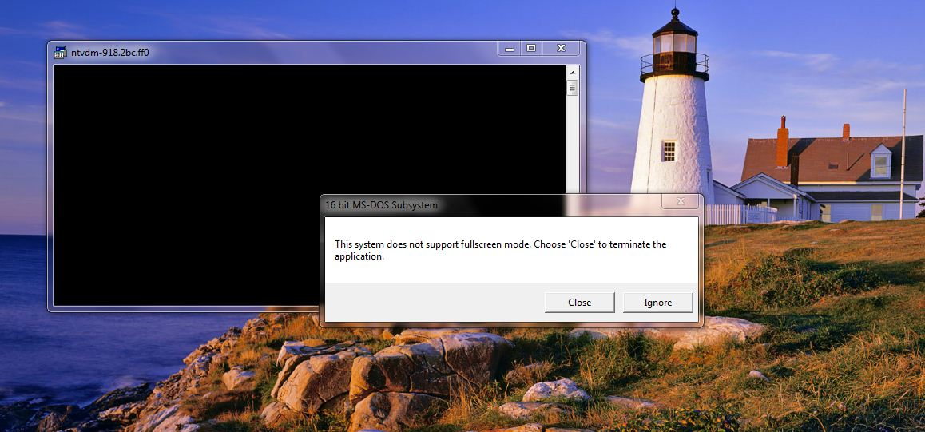
Issue #1
Fig 1. 16-bit apps not running on windows 7. n higher

Slide 4
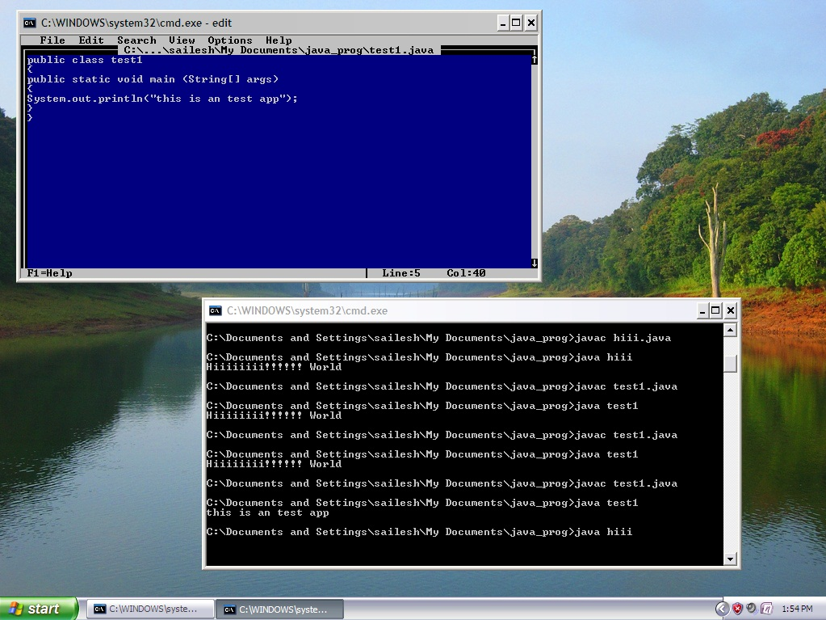
Issue#2
Fig 2. cumbersome process of Programming in java..??

Slide 5
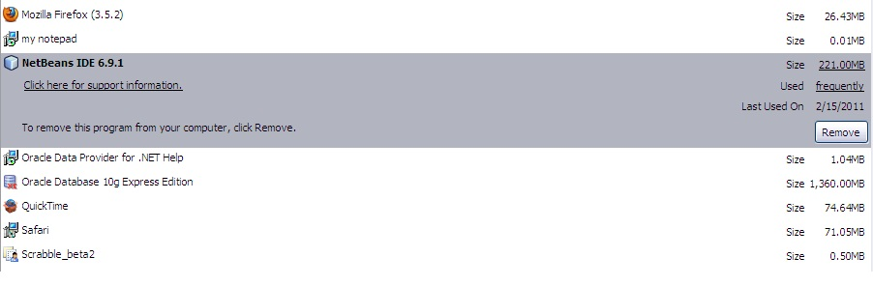
Issue#3
Fig 3. Using heavy IDE’s-wastage of system resources.

Slide 6
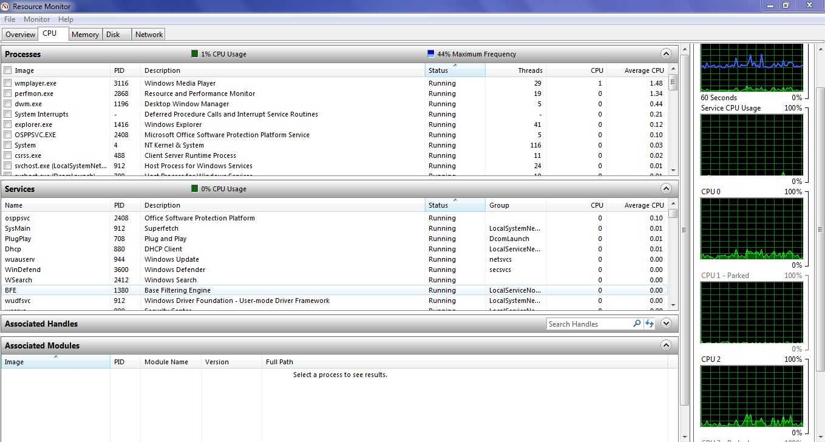
Issue#4
Fig 4. Developing programs without target platform info( processor –core information).

Slide 7
Problem #5

Slide 8
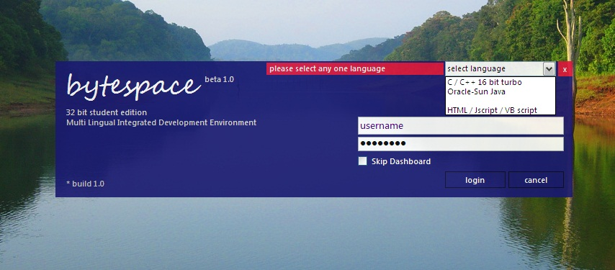
Solution
Fig 5. Bytespace beta 1.0 – code named as “ Project Sramble”

Slide 9
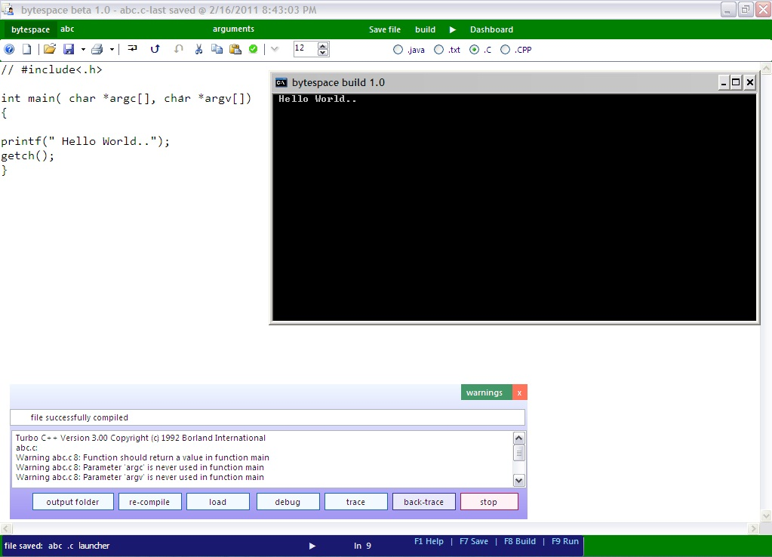
Solution #1
Fig 5. Bytespace beta 1.0 – running Turbo C++ version 3.00

Slide 10
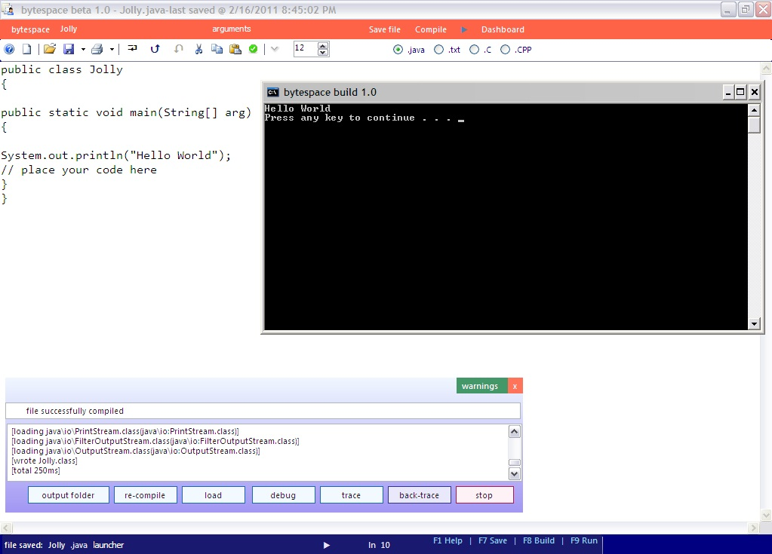
Solution #2
Fig 5. Bytespace beta 1.0 – running Java SDK 6.0

Slide 11
Solution #3
The New Way of Debugging – Tracing Route of Program Execution.
Why are breakpoints used?
> to put stops to execution paths, so as to figure out which segment of the program contains the bug.
What's new?
> tracing the route the program took, hence knowing which branch got executed, which if block was executed and which wasn’t.

Slide 12
More features
Profiler
Gets a snapshot of the environment in which the program is running.
Collects run-time data like system memory space utilized, number of processes running on system, if connected to net; network details, etc.
Code analysis
Shows the assembly level code for C/C++
Multi threaded Debugging
Each of the program that a developer creates, runs as a new thread.

Slide 13
Walk-through
C/C++
HTML
Java

Slide 14
Limitations
Code-assist features
Syntax highlighting and auto-complete feature removed.
Project management
Will be made available in higher versions of the product.
Black box testing
Will be automated in higher versions of the product.
Help documentation
Will be shortly made available online.

Slide 15
Questions ?
Saileswar kumar Mahakud,
me.saileshkumar@gmail.com .
Thank you all.

